Slide 1
Story Telling in the Business World.
By: Colin Hite

Slide 2
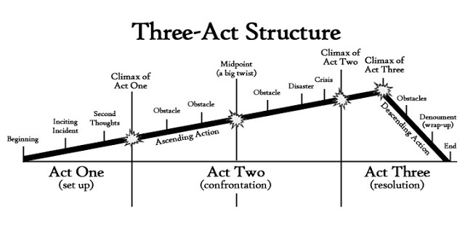
Story Structure.
3 Act Story
https://www.nownovel.com/blog/wp-content/uploads/2014/02/3-act-structure.jpg

Slide 3

The Customer
https://assets.entrepreneur.com/content/3x2/1300/20150120195207-customer.jpeg

Slide 4

The Good And the Bad
https://theater-masks.com/wp-content/uploads/2015/02/comedy-tragedy-decorative-masks.jpg

Slide 5

The Sale
https://moviewriternyu.files.wordpress.com/2014/01/money.jpg

Slide 6

Employee Positions
Seasonal
Part-timer
Full-timer
Assistant manager
Manager
Reginal Manger
District Manager
https://odysseyonline-img.rbl.ms/simage/http%3A%2F%2Fcdn1.theodysseyonline.com%2Ffiles%2F2016%2F02%2F22%2F635917076783020956-1943515409_dwight.jpeg/2000%2C2000/%2FjjfNrRFBJ7kfOhY/img.jpeg

Slide 7
https://www.youtube.com/watch?v=1rMnzNZkIX0

Slide 8

Thanks For Watching!

